Slide 1
C# ADO.net Examples
Data Source: Internet

Slide 2
Use of DataSet
In this program, we create 2 DataTables. One stores 2 rows of patient information. And the second stores 2 rows of medication information.
Next We create a DataSet with the DataSet constructor. Then we add the 2 DataTables to the DataSet instance.
Finally we print the XML.

Slide 3
using System;
using System.Data;
class Program
{
static void Main()
{
// Create 2 DataTable instances.
DataTable table1 = new DataTable("patients"); table1.Columns.Add("name"); table1.Columns.Add("id");
table1.Rows.Add("sam", 1);
table1.Rows.Add("mark", 2);
DataTable table2 = new DataTable("medications"); table2.Columns.Add("id"); table2.Columns.Add("medication"); table2.Rows.Add(1, "atenolol"); table2.Rows.Add(2, "amoxicillin");
// Create a DataSet and put both tables in it.
DataSet set = new DataSet("office"); set.Tables.Add(table1);
set.Tables.Add(table2);
// Visualize DataSet. Console.WriteLine(set.GetXml()); } }

Slide 4
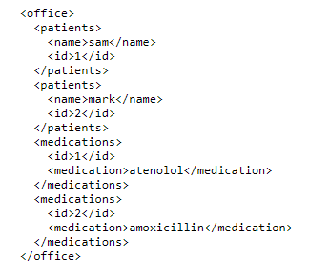
Output:

Slide 5
Introduction
The code in this example assumes that you can connect to the Microsoft Access Northwind sample database.
The code creates a OleDbCommand to select rows from the Products table, adding a OleDbParameter to restrict the results to rows with a UnitPrice greater than the specified parameter value, in this case 5.
The OleDbConnection is opened inside of a using block, which ensures that resources are closed and disposed when the code exits.
The code executes the command by using a OleDbDataReader, and displays the results in the console window.

Slide 6
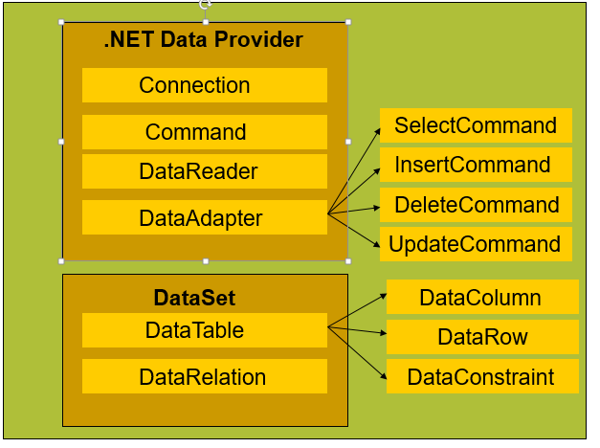
ADO.net Structure

Slide 7
using System;
using System.Data;
using System.Data.OleDb;
class Program
{
static void Main()
{
string connectionString = "Provider=Microsoft.Jet.OLEDB.4.0;Data Source=" + "c:\\Data\\Northwind.mdb;User Id=admin;Password=;";
string queryString = "SELECT ProductID, UnitPrice, ProductName from products " + "WHERE UnitPrice > ? " + "ORDER BY UnitPrice DESC;";
int paramValue = 5; OleDbConnection connection = new OleDbConnection(connectionString);
OleDbCommand command = new OleDbCommand(queryString, connection); command.Parameters.AddWithValue("@pricePoint", paramValue);

Slide 8
try
{
connection.Open();
OleDbDataReader reader = command.ExecuteReader();
while (reader.Read())
{ Console.WriteLine("\t{0}\t{1}\t{2}", reader[0], reader[1], reader[2]); } reader.Close();
} catch (Exception ex)
{
Console.WriteLine(ex.Message);
}
Console.ReadLine();
}
}

Slide 9
Using DataReader
private void button1_Click(object sender, EventArgs e)
{
try
{
string connstr = @"Provider=Microsoft.ACE.OLEDB.12.0;Data Source=C:\Users\Taimur Sattar\Documents\DB_test.accdb;
Persist Security Info = False";
OleDbConnection conn = new OleDbConnection(connstr);
conn.Open();
MessageBox.Show("Connection successfull..");
string qry = "Select * from Student";
OleDbCommand cmd = new OleDbCommand(qry, conn);
OleDbDataReader dr = cmd.ExecuteReader();
while(dr.Read())
{
MessageBox.Show(dr["Roll_no"].ToString());
}
}
catch(Exception ex)
{
MessageBox.Show(ex.Message);
}
}
Notes:
The example uses an integer array as a data source for convenience; however, the same concepts apply to other data sources also.

Slide 10
Using ExecuteNonQuery()
private static void CreateCommand(string queryString, string connectionString)
{
//queryString is any INSERT, UPDATE or DELETE query
using (SqlConnection connection = new SqlConnection( connectionString))
{ SqlCommand command = new SqlCommand(queryString, connection); command.Connection.Open();
int res= command.ExecuteNonQuery(); //returns no. of rows affected by the command
}
}
Notes:
The example uses an integer array as a data source for convenience; however, the same concepts apply to other data sources also.

Slide 11
Using ExecuteScalar()
Use the ExecuteScalar method to retrieve a single value (for example, an aggregate value) from a database. This requires less code than using the ExecuteReader method, and then performing the operations that you need to generate the single value using the data returned by a SqlDataReader.
Examples:
cmd.CommandText = "SELECT COUNT(*) FROM dbo.region"; Int32 count = (Int32)cmd.ExecuteScalar();
Notes:
The example uses an integer array as a data source for convenience; however, the same concepts apply to other data sources also.

Slide 12
Using ExecuteScalar()
static public int AddProductCategory(string newName, string connString)
{
Int32 newProdID = 0; string sql = "INSERT INTO Production.ProductCategory (Name) VALUES (@Name); " + "SELECT CAST(scope_identity() AS int)";
using (SqlConnection conn = new SqlConnection(connString))
{
SqlCommand cmd = new SqlCommand(sql, conn); cmd.Parameters.Add("@Name", SqlDbType.VarChar); cmd.Parameters["@name"].Value = newName;
try
{
conn.Open();
newProdID = (Int32)cmd.ExecuteScalar();
} catch (Exception ex)
{ Console.WriteLine(ex.Message); }
} return (int)newProdID;
}
Notes:
The example uses an integer array as a data source for convenience; however, the same concepts apply to other data sources also.

Slide 13
DataSet Introduction
1. Open connection
2. Fill the DataSet
3. Close connection
4. Process the DataSet
5. Open connection
6. Update the data source
7. Close connection

Slide 14
Using DataSet
// Assumes that connection is a valid SqlConnection object.
string queryString = "SELECT CustomerID, CompanyName FROM dbo.Customers";
SqlDataAdapter adapter = new SqlDataAdapter(queryString, connection);
DataSet customers = new DataSet(); adapter.Fill(customers, "Customers");

Slide 15
Using Dataset with multiple tables and datasources
// Assumes that customerConnection is a valid SqlConnection object.
// Assumes that orderConnection is a valid OleDbConnection object.
SqlDataAdapter custAdapter = new SqlDataAdapter( "SELECT * FROM dbo.Customers", customerConnection);
OleDbDataAdapter ordAdapter = new OleDbDataAdapter( "SELECT * FROM Orders", orderConnection);
DataSet customerOrders = new DataSet(); custAdapter.Fill(customerOrders, "Customers"); ordAdapter.Fill(customerOrders, "Orders");
DataRelation relation = customerOrders.Relations.Add("CustOrders", customerOrders.Tables["Customers"].Columns["CustomerID"], customerOrders.Tables["Orders"].Columns["CustomerID"]);
foreach (DataRow pRow in customerOrders.Tables["Customers"].Rows)
{
Console.WriteLine(pRow["CustomerID"]);
foreach (DataRow cRow in pRow.GetChildRows(relation))
Console.WriteLine("\t" + cRow["OrderID"]);
}
Notes:
The example uses an integer array as a data source for convenience; however, the same concepts apply to other data sources also.

Slide 16
Links:
https://docs.microsoft.com/en-us/dotnet/framework/data/adonet/ado-net-code-examples
Links for using Datasets
https://docs.microsoft.com/en-us/dotnet/framework/data/adonet/dataset-datatable-dataview/
For connection strings use following link:
https://www.connectionstrings.com

